Slide 1
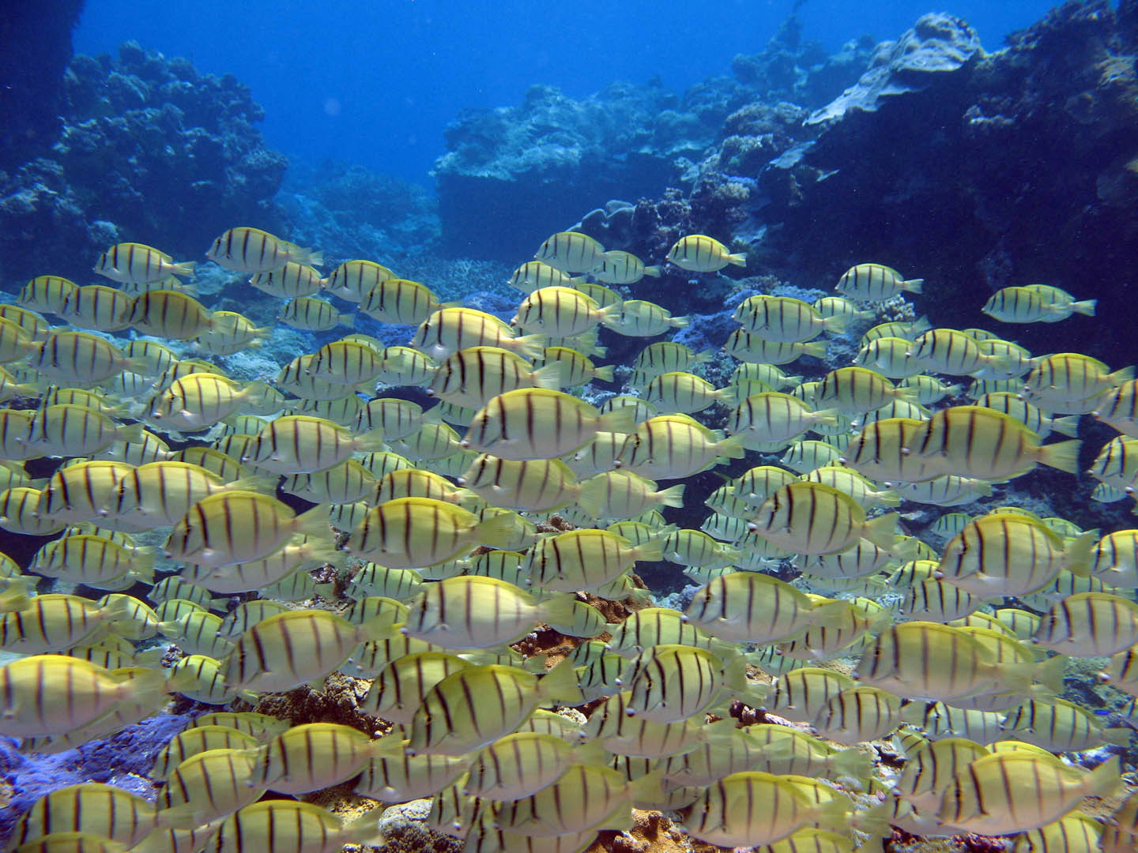
Systematic effects of fishing on global coral reef herbivore populations
Clinton Edwards, Scripps Institution of Oceanography
Co-Authors: Jennifer E. Smith, Stuart A. Sandin, Brian Zgliczynski, Alan Friedlander, Ivor Williams, Alison Green, Hugh Sweatman, Marah Hardt
Notes:
I will be presenting work conducted as part of my Biology Masters thesis at Scripps Inst. Oceanography and UCSD, determining global levels of herbivorous fish biomass and impacts due to fishing….
This work was conducted by myself and a the coauthors listed here….

Slide 2
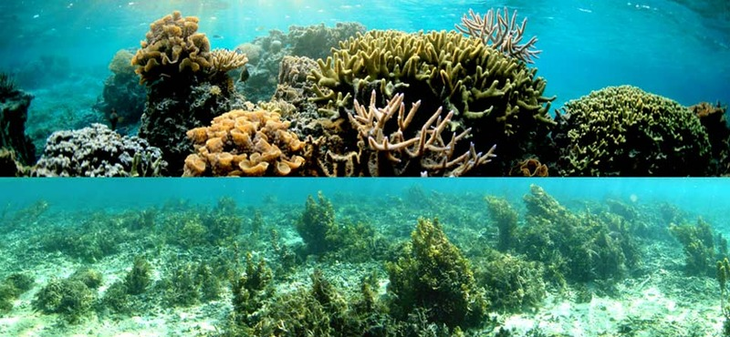
The problem…
Notes:
On tropical coral reefs There is an alarming incidence of shifts from dominance by corals and other calcifiers to dominance by fleshy macroalgae and turf species
These shifts, known as phase shifts ultimately result in reductions of the structure and function of these reefs, a diminished capacity of these ecosystems to provide habitat and shelter for numerous reef organisms
As a community we seek an understanding of the causes and consequences of these phase shifts, as well as particular solutions and management strategies that will allow us to prevent and reverse these shifts n the future

Slide 3
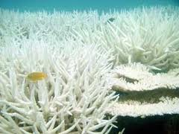
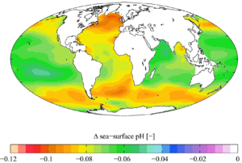
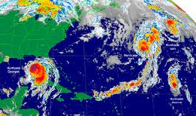
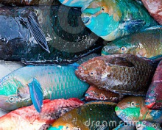
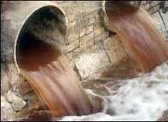
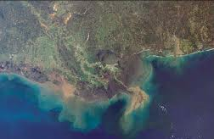
Causes of reef decline…
Global Stressors:
Warming
Acidification
Tropical Storms
Local Stressors:
Overfishing
Pollution
Coastal Development
Notes:
Numerous factors are known to cause declines in coral health and abundance. Globally…. warming, acidification and storm damage can all cause coral mortality and negatively affect coral communities at least in the short term.
Locally, and at the scale most relevant to resource managers a reduction in herbivory caused by overfishing, nutrient pollution and coastal development are the primary disturbances that can alter benthic competitive dynamics to favor the growth and proliferation of fleshy algae relative to that of corals and other reef builders
On healthy reefs coral reef herbivores are believed to regulate coral-algal competition by maintaining low algal standing stocks and facilitating coral recruitment

Slide 4
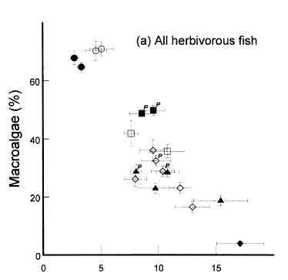
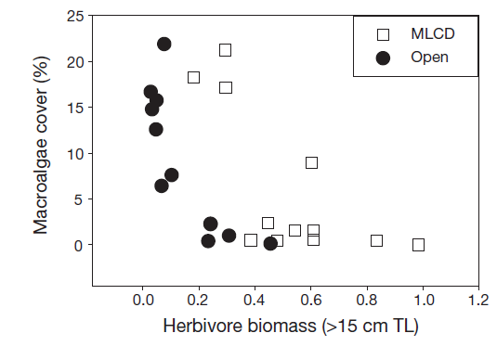
Top-down influence of herbivory
Biomass g m-2
Caribbean
Pacific
Herbivore biomass and macroalgal cover are negatively correlated
Williams (2001), Friedlander et al. (2007)
Notes:
Evidence from many observational and experimental studies have demonstrated the ability herbivorous fishes to exhibit strong top-down control on the % cover and abundance of algae on reefs
Here are two classic studies, from the caribb (L) and the pacific (R) , which show strong correlations of reduced macroalgal cover with increasing herbivore biomass, suggesting direct influence by herbivores on the structure and composition of benthic communities in these areas
Axis not shown for the graph on the left but it is g/m^2

Slide 5
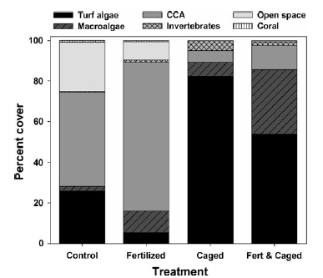
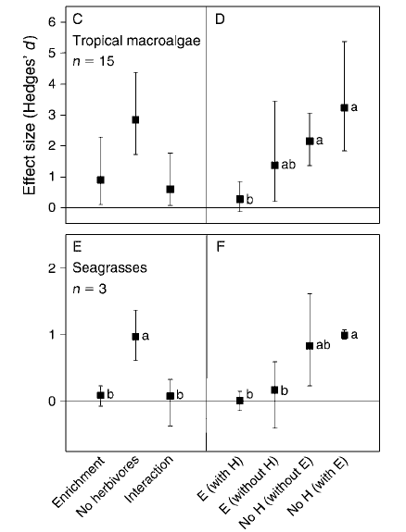
Top-down influence of herbivory
Experimental herbivore removal consistently leads to an increase in fleshy algae
Smith et al (2010), Burkepile et al (2006)
Notes:
Additionally Results from experimental studies have almost unequivocally shown that herbivore exclusion consistently leads to increases in turf and macroalgae cover on reefs.
The figure on the left are results from a long term experimental manipulation of herbivory and nutrient availability….and show that herbivore exclusion plots, relative to the control, had much greater levels of macroalgae and turf algae compared to plots accessible to grazers….
The figure on the right is from a meta-analysis evaluating experiments which manipulated herbivore density and observed benthic response. It shows a strong tendency for the exclusion of herbivores to lead to greater growth and proliferation of algae across multiple experiments.

Slide 6
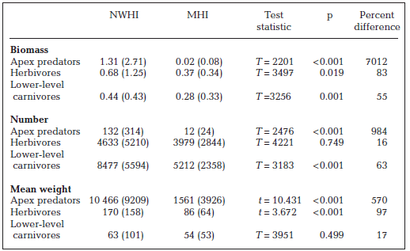
Evidence for exploitation
(Protected)
(Fished)
Lower biomass, fewer numbers and smaller sized herbivores in fished areas
Friedlander (2004)
Notes:
Despite the clear importance of herbivorous fish on reefs, and the potential for their use in management strategies, evidence shows that in some places there has been significant depletion of this group
Here I show results from a study that examined fish biomass and abundance between fished and unfished regions in the Hawaiian islands
The unfished NWHI’s feature higher biomass, abundance and generally larger fish than are found in the nearby main Hawaiian islands…clearly we can see an impact of human habitation and exploitation in these data

Slide 7
The need for research
Herbivores are important for healthy reef structure & function
But…
  What is the global status of coral reef herbivorous fish populations?
  Is there evidence for fishing effects?
  Are different feeding guilds affected differently?
Notes:
there are clear lines of evidence of the function of herbivores and their potential to aid in resilience and recovery on coral reefs . Though, for mangaement strategies using herbivore mediated restorations to be succefull, we must first establish meaningful and realistic targets. We must have an idea of Natural levels of biomass and abundance on pristine reefs; knowledge of the Variability between regions and a clear picture of the effects of exploitation on this group. Additionally we must gain information on how fishing effects the structure of this group of fishes
---or---
Though there are clear lines of evidence demonstrating function of herbivores and their potential to aid in resilience and recovery on coral reefs …..
we are lacking a synthesis of herbivore populations around the world with information on baseline levels and variability in biomass, abundance and potential effects due to fishing pressure. Likewise, we do not have a clear picture of the effects of exploitation on the structure of this group of fishes.

Slide 8
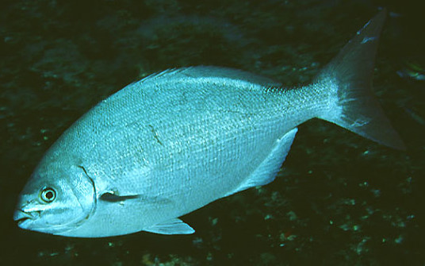
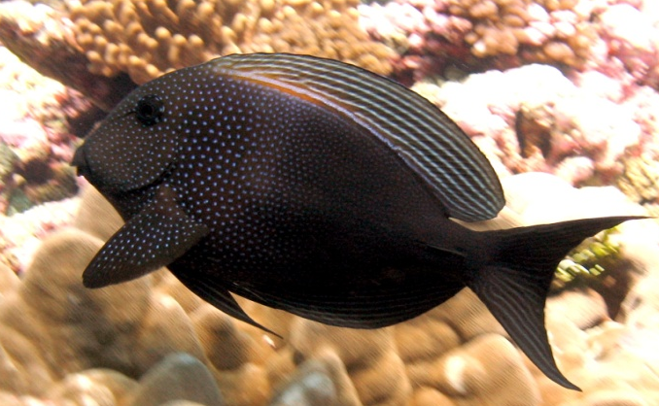
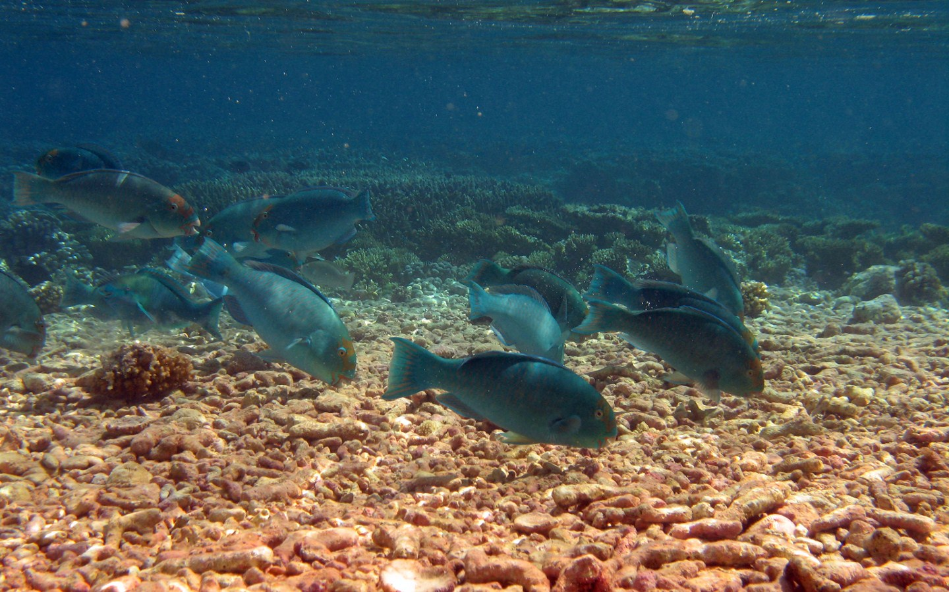
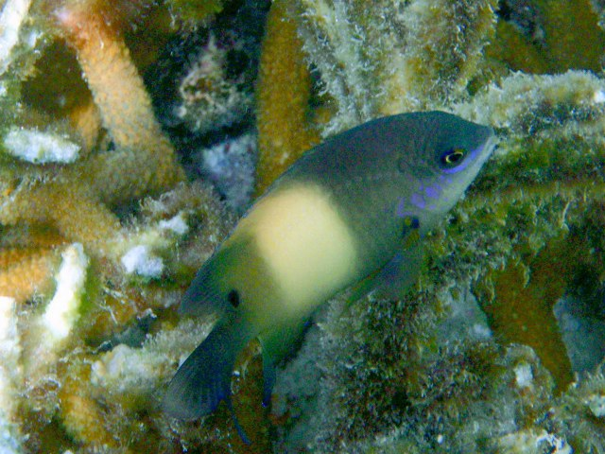
Herbivore functional groups
Functional subgroups are based on different feeding modes
Different feeding modes result in variable impacts to the reef matrix
Browsers
Grazer / Detritivores
Photo: Minguell, C.
Photo: Jen Smith
Scraper / Small Excavators
Territorial Damselfish
Photo: Jen Smith
Photo: Rainer Kretzberg
Notes:
Important when considering the role of the herbivores is the idea of functional diversity within the herbivore guild. There are several feeding sub-guilds, or functional groups that are defined by the manner in which they feed and interact with the reef matrix
Browsers focus primarily on macro algae, take large bites are do not alter the substratum
Grazer detritivores have high grazing rates and focus heavily on algal turfs and feed without altering the underlying substratum
Scrapers and excavators also focus primarily on algal turfs however they scrape and sometime even excavate the underlying substrate, exposing bare space for potentially colonizing cca’s and corals
The final group that we consider are the Territorial damselfish. This group cultivates specific algal assemblages within their territories…..and aggresively repel conspecifis. Their territories have been found to be refuges for macro algae and cyano bacteria. Several studies have suggested elevated territorial damsels density is liked to decline in reef health

Slide 9
Herbivore density project
Our Goals:
Identify natural levels of herbivore populations on pristine reefs and document variability
Determine evidence for fishing effects
Determine exploitation effects on functional groups
Methods:
Develop a comprehensive database of worldwide herbivore biomass/abundance levels
Systematic literature review
Governmental and other monitoring programs: CRED, TNC, AIMS
Notes:
In the present study our goals were to
First To identify natural levels of herbivore populations on pristine reefs globally, and document variability
Additionally we sought to Determine evidence for fishing effects
Finally we investigated the effects of exploitation on the different functional groups
In order to provide this information we sought to establish a comprehensive worldwide database of herbivore biomass , abundance and community structure.
We conducted a rigorous search of the peer reviewed literature for estimates of herbivore biomass and abundance. Additionally we consolidated data from monitoring programs and unpublished data collected by the authors

Slide 10
Methods: data collection
Institute for Scientific Information (ISI) Web of Science database
  1980-2011
  Search terms= herbiv*, biomass, abundance, herbiv* and assemblage, etc.
Qualitative or quantitative description of depth, reef zone (fore reef, reef crest, etc.) and reef type (barrier reef, atoll, etc.)
Site location information and time period of study
Rigorous and peer reviewed method for evaluating fish biomass and/or abundance (SPC or belt)
Report abundance and/or biomass means of all major herbivorous fishes found in the study area
Fisheries accessibility
Unpublished monitoring datasets were subject to the same criteria
Notes:
In Our literature search the following criteria were required
1-- Qualitative or quantitative descriptions of depth, reef zone and reef type
2--Site location information
3—Use of Accepted census methods
4—and estimates of the full herbivore assemblage
5—We also had to be able to determine fisheries accessibility at the sites where surveys were conducted
Data varied in level of resolution, most significantly in terms of sampling design and taxonomic detail. Sample sizes of analyses reflect the availability of data specific to the question addressed.

Slide 11
Methods: fisheries accessibility
Fisheries accessibility was designated based upon human habitation, isolation and level of protection at each site where surveys were conducted
Two levels of fishing activity
  “not fisheries accessible” (NFA)
  “fisheries accessible” (FA)
Notes:
Fisheries accessibility was designated based upon human habitation, isolation and level of protection at each site where surveys were conducted.
Not fisheries accessible, or NFA sites, were those located on remote and uninhabited islands where fishing is formally banned or severely limited due to remoteness. Sites on inhabited islands or coastlines but inside a marine protected area were also designated as NFA. As the efficacy of no-take marine reserves is a function of compliance, enforcement, and reserve age, we identified sites within marine reserves as NFA if they had a minimum duration of protection from fishing of 6 years, adequate enforcement and evidence of compliance.
FA sites were those which due to accessibility and regulations are likely to experience fishing activity.

Slide 12
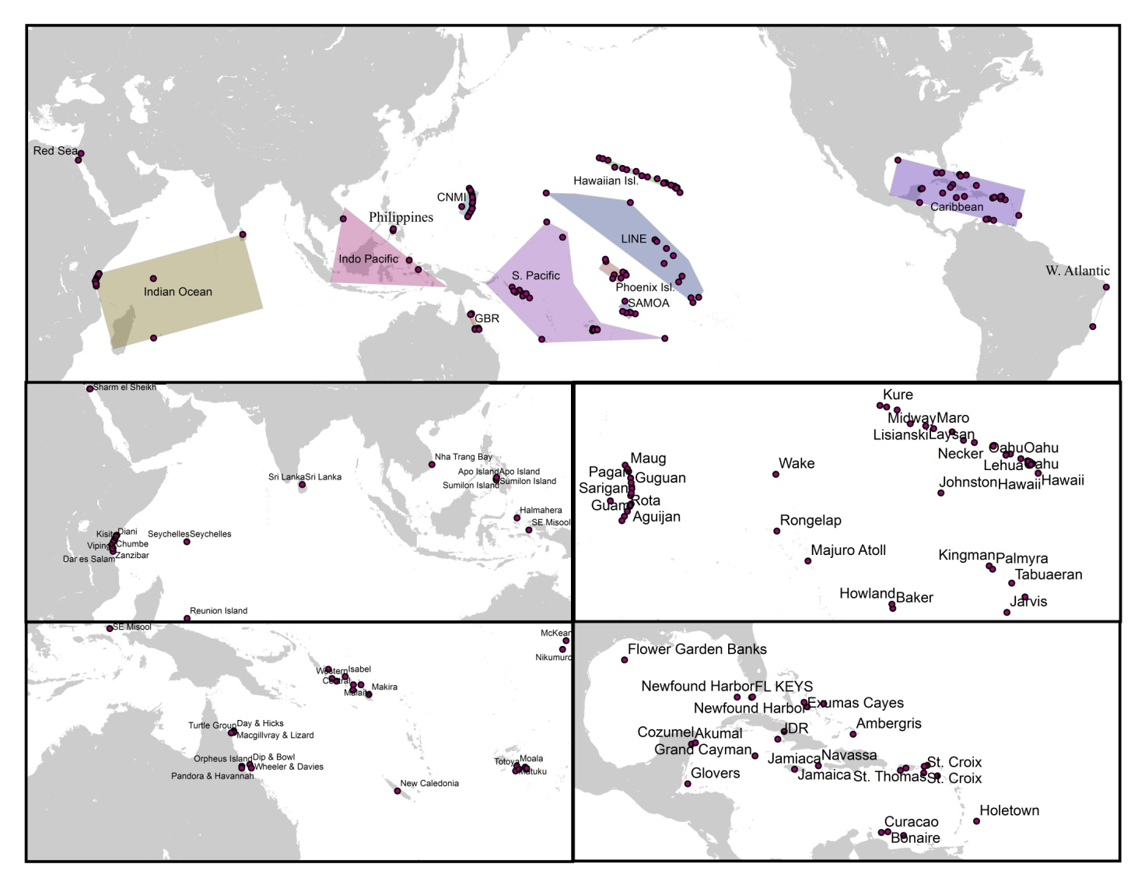
Methods: analysis
Global means of biomass and abundance for NFA and FA areas
Differences between NFA and FA locations within regions
Functional group analysis
Notes:
(i) To determine if there were differences in the abundance and biomass of herbivores between NFA and FA locations worldwide we compiled all available estimates and used a two sample t-test to determine the significance of any differences
(ii) When determining Regional Means, For some regions biomass data were non-normal, making use of parametric statistical procedures inappropriate. Further, data were not evenly available across study regions leading to an unbalanced design in comparing NFA to FA ‘treatments’. Therefore we employed a rigorous non-parametric bootstrapping procedure to calculate distributions of regional mean differences of FA from NFA areas
(iii) To test whether fisheries accessibility alters the structure of the herbivore guild worldwide we employed a similar non-parametric bootstrapping procedure and generated a distribution of biomass ratios for NFA to FA locations for the different functional groups.

Slide 13
Results: data collection
300+ studies from search criteria
Only 75 studies meet full criteria
Unpublished datasets from Indonesia, Pacific Islands, Caribbean, Hawaii, GBR & Indian Ocean
2706 site level estimates of biomass and abundance from 145 locations
Notes:
We collected 75 studies from the literature and unpublished datasets from around the world …..Ultimately we were able to use 2706 site level estimates of biomass and abundance from 145 locations worldwide
Though we initially encountered 300+ studies……We were surprised how few studies from literature met our criteria…..
Thankfully, we had access to previously unpublished datasets from many locations around the globe that allowed us to increase the geographic extent of the dataset.

Slide 14
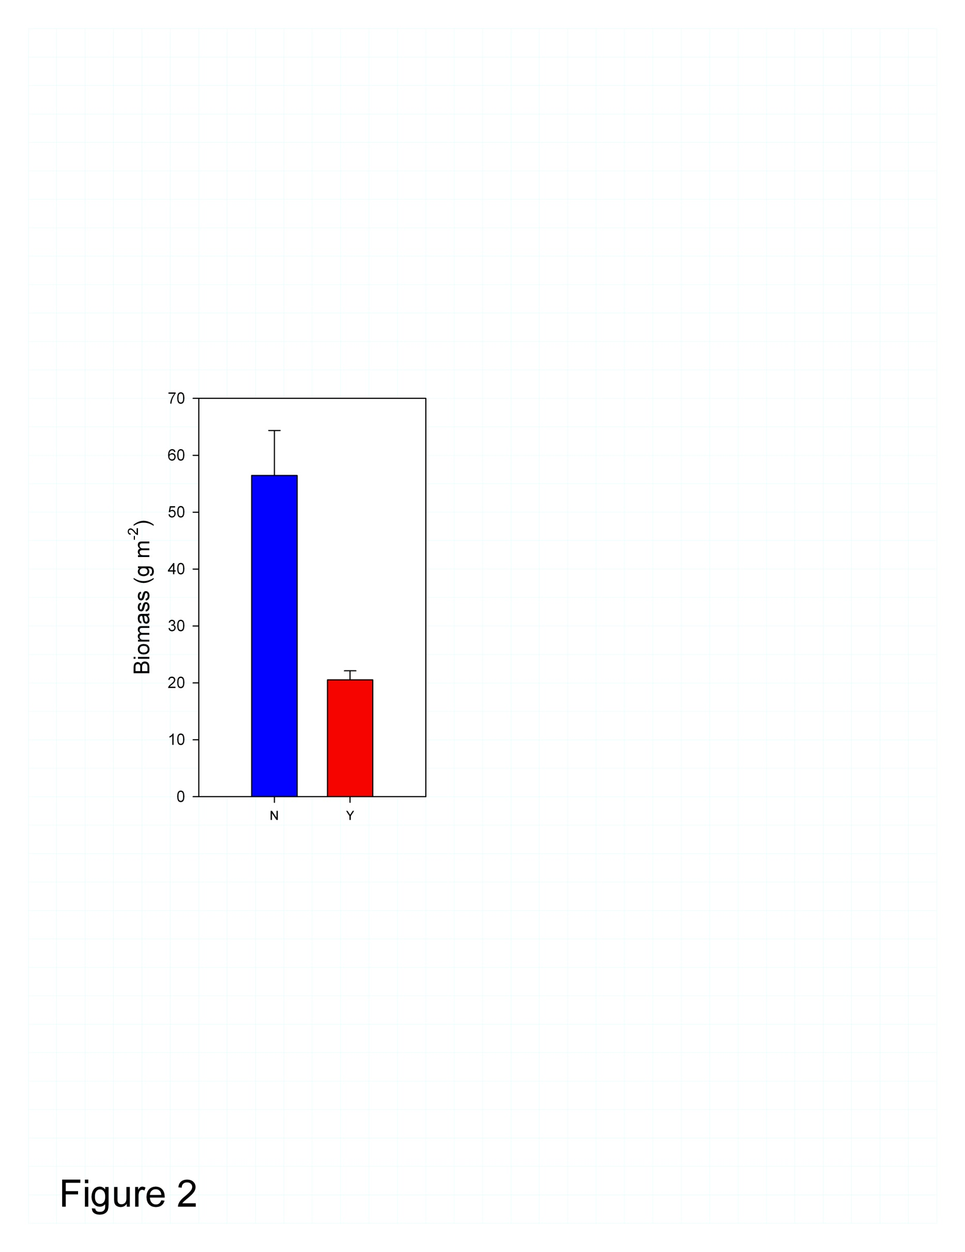
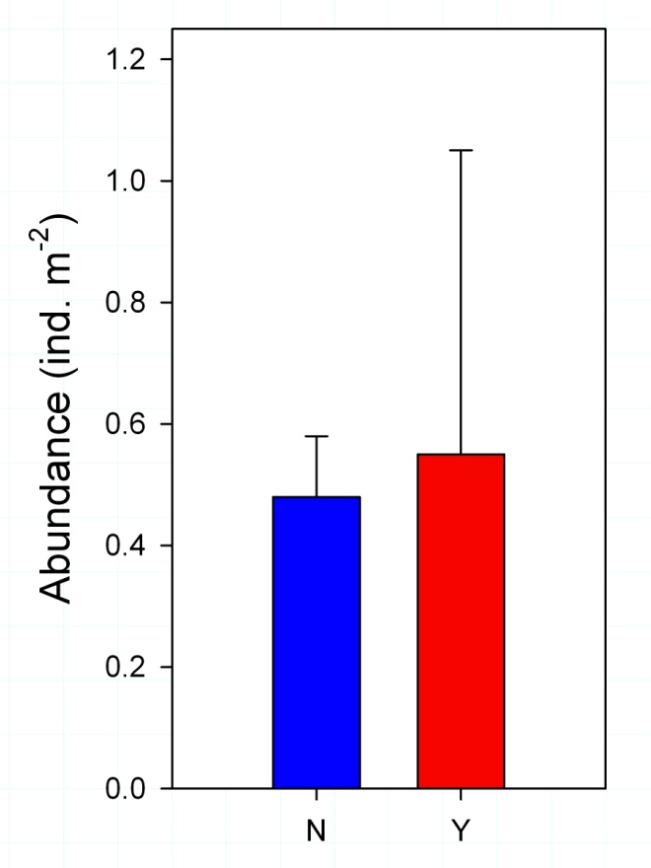
Results: overall biomass & abundance
Not Fisheries
Accessible (NFA)
Fisheries
Accessible (FA)
NFA
FA
NFA
FA
Notes:
Using all available estimates
The grand mean biomass of all herbivores at NFA areas was 56.4 g m^{­-2} (±7.9 SE) which was significantly different than that at FA locations which had only 20.5 g m^{­-2} (±1.6 SE).
At NFA locations total numerical density was 0.48 individuals m^{­-2} (±0.13 SE), while at FA locations abundance was 0.55 individuals m⁻² (±0.54 SE), though the difference was not significant.
We see here that the greater than two-fold decline in herbivore biomass is not met with an equivalent drop in numerical abundance suggesting that FA areas are likely dominated by a relatively greater number of smaller-bodied fish.
This shift in size structure at FA locations may have important consequences on the emergent foraging capacity of the herbivore guild as there are size dependent effects, within and among species, on algal consumption. Larger individuals generally consume greater volumes of algae, both overall and per unit biomass and expose larger areas of substratum

Slide 15
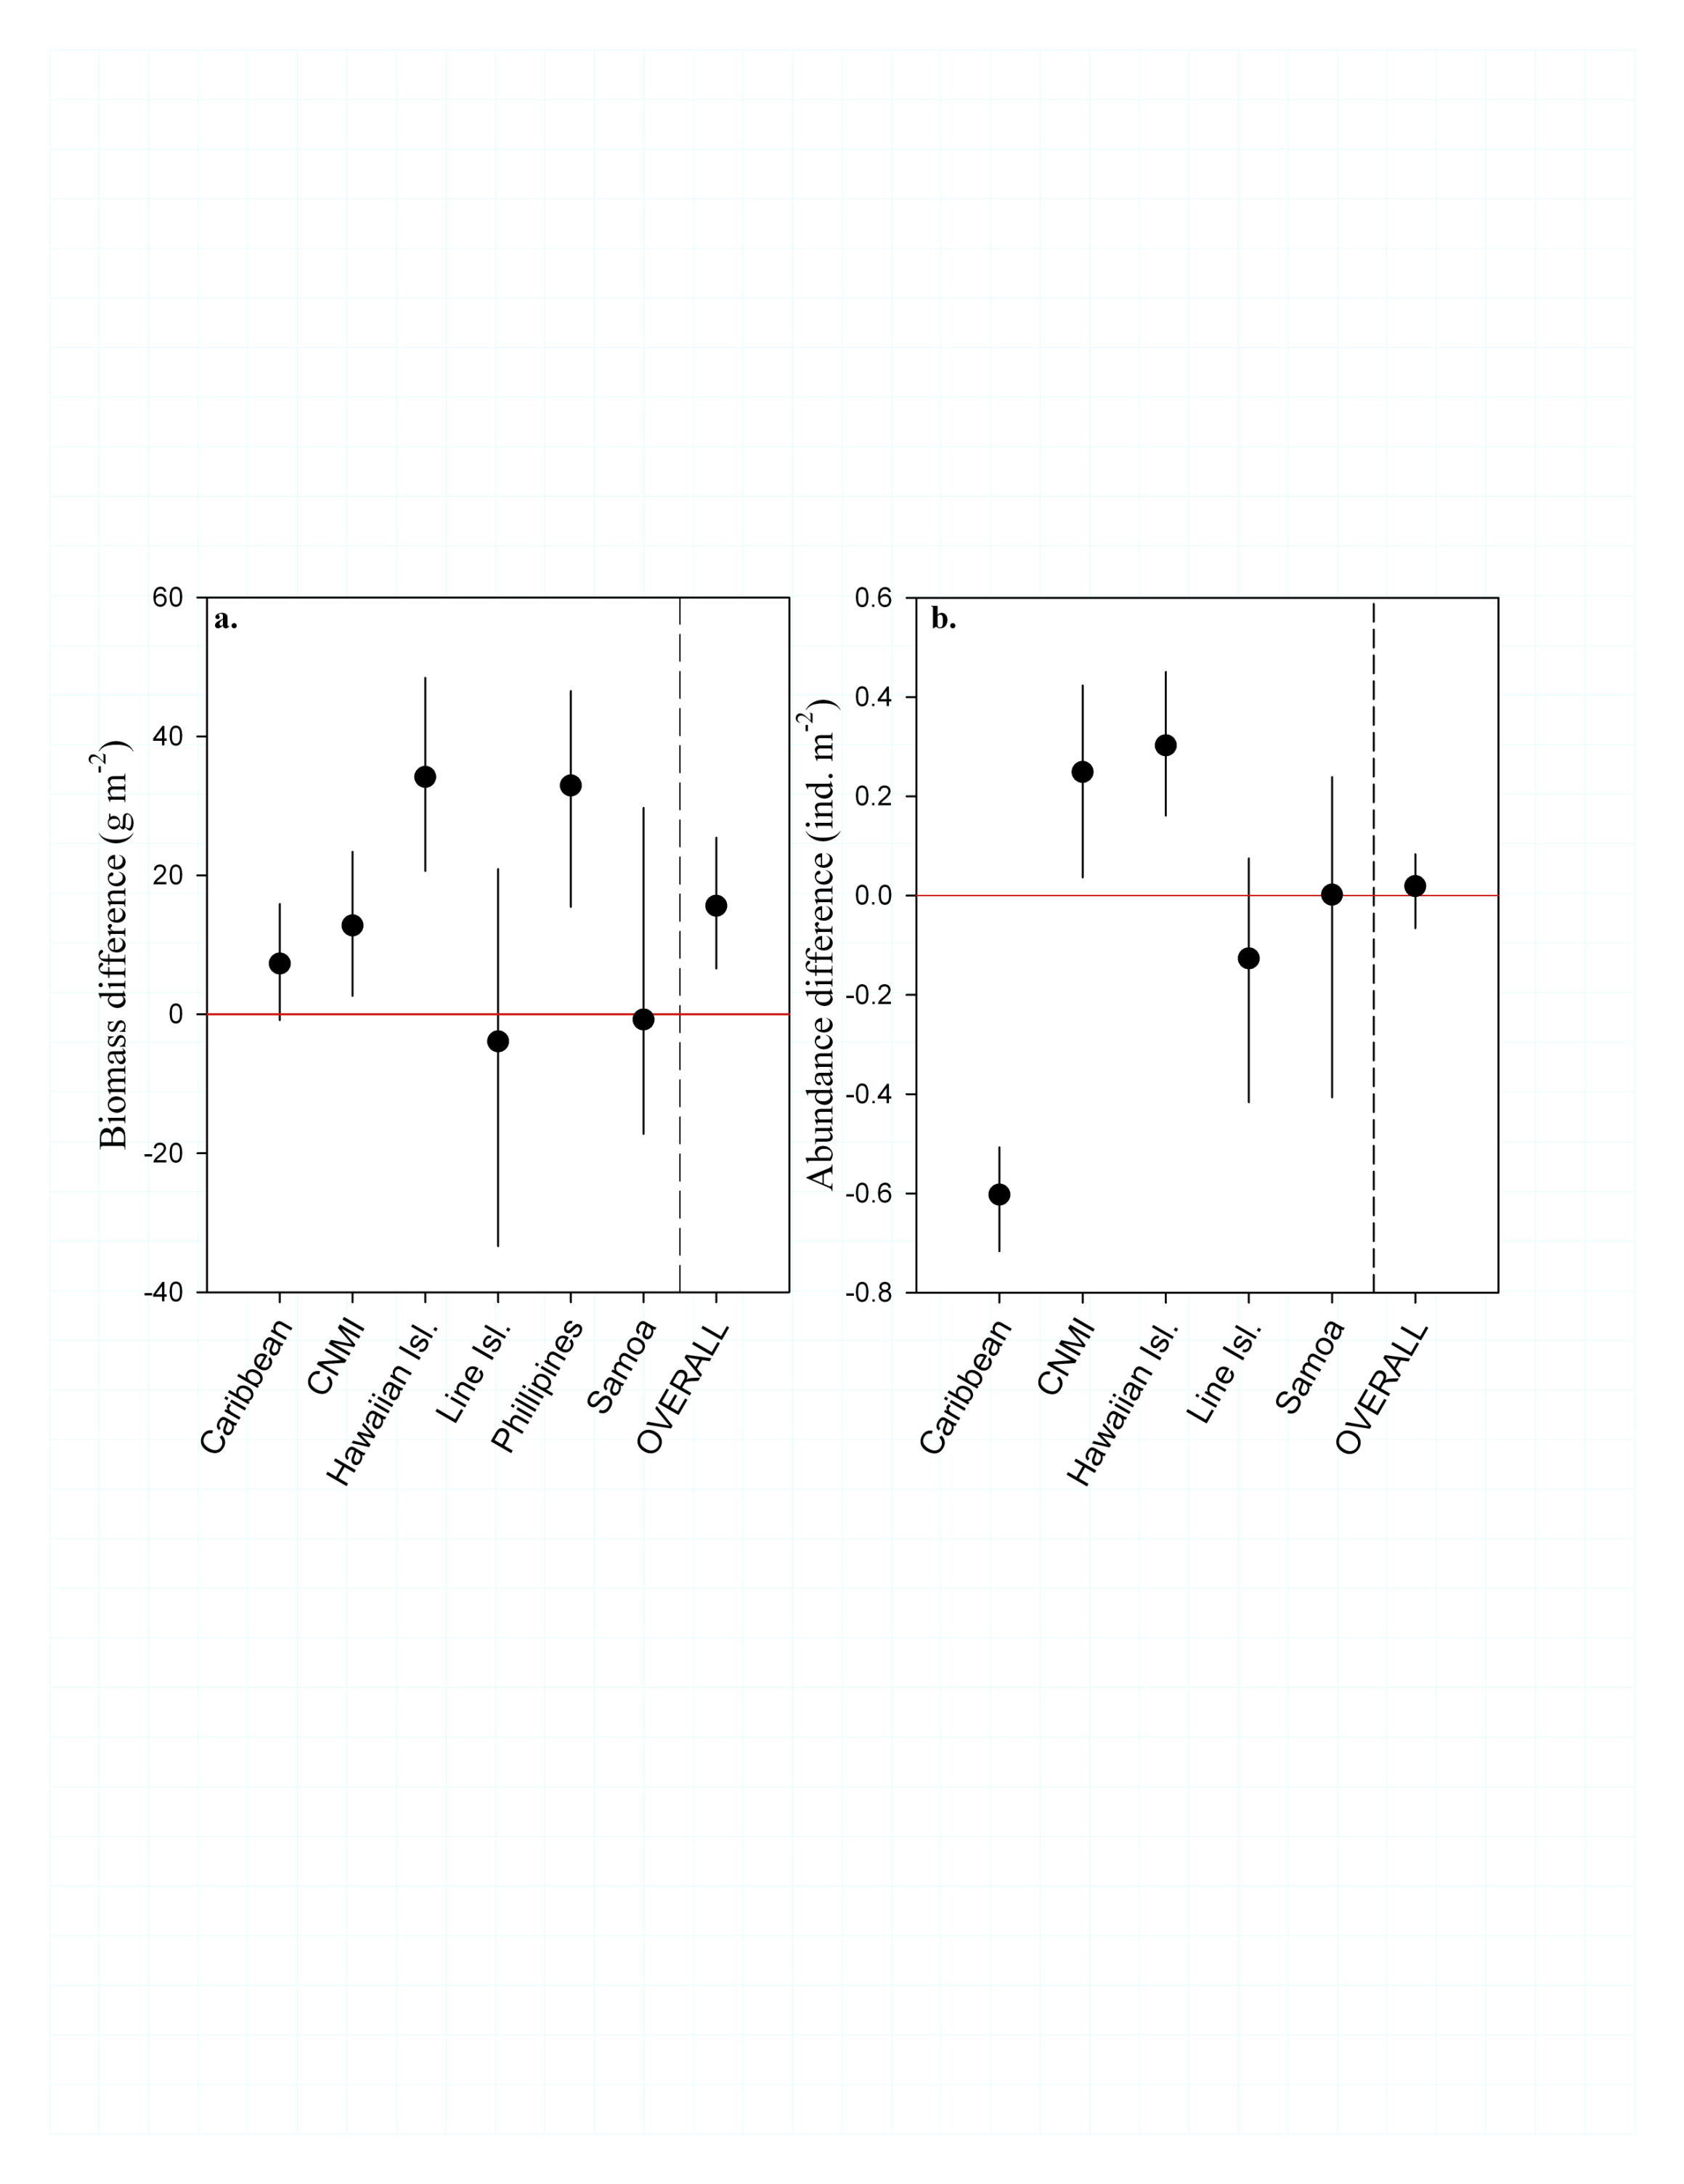
Results: regional effects of fishing
Notes:
Where data was available we conducted analysis of mean differences in biomass and abundance of NFA minus FA locations within regions
On the plots shown here Black circles are the median mean difference and lines indicate 95% QR ranges of the bootstrapping analysis. QR ranges greater than 0 are indicative of greater biomass as NFA locations relative to FA ones.
There was considerable variability in biomass within and among regions but there was an overall tendency for NFA locations to support higher herbivore biomass than FA locations, indicating that the exploitative effects of fishing likely have moderate to strong reductions in the biomass of the herbivore guild in the regions analyzed
In contrast, the 95% QR of the mean difference in abundance worldwide overlaps 0, with some regions having higher numerical abundance and others having lower abundance or demonstrating no difference . This indicates that the effects of fishing pressure on the numerical abundance of herbivorous fishes are perhaps more complicated than the effects on biomass.

Slide 16
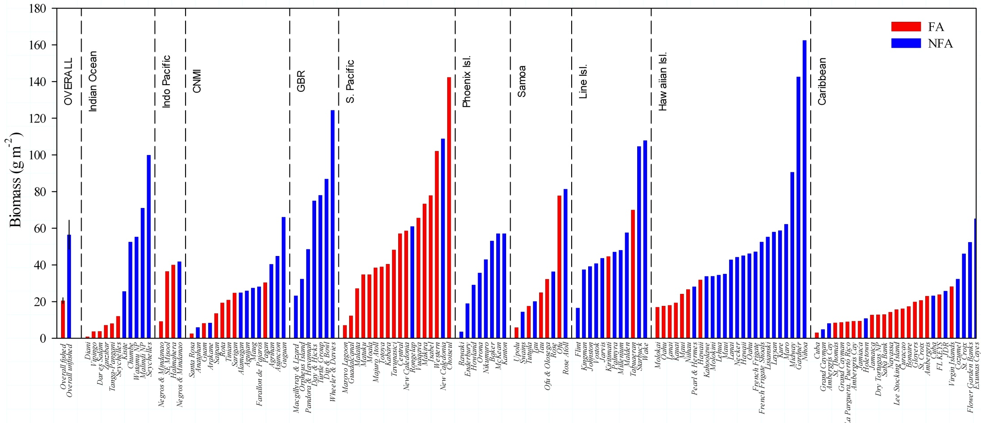
Results: world-wide island level herbivore biomass
Notes:
The 145 locations included in this analysis span a wide range of environmental and oceanographic parameters that are known to influence the structure of local fish stocks. Despite such variability, our analysis shows evidence that herbivorous fish assemblages not accessible to fisheries are consistently more massive
Perhaps most striking result in our global summary is the extreme range herbivore biomass values across locations, in particular the high values reported from some remote and protected NFA locations. For example, locations across the Pacific , GBR and Indian Ocean (the Seychelles) have herbivore biomass values exceeding 100 g m⁻²
…while FA locations in Jamaica, The Commonwealth of the Marianas and E. Africa had biomass values less than 10g/m^-2
Clearly not all sites in all regions have the same biomass potential…..however even in the highly impacted Caribbean where long histories of exploitation and a depauperate herbivore assemblage have been suggested as constraints on herbivore biomass’….several locations not accessible to fisheries, including Saint Croix , the Exumas Cayes and the Flower Garden Banks have biomass values near or greater than 50g/m^-2

Slide 17
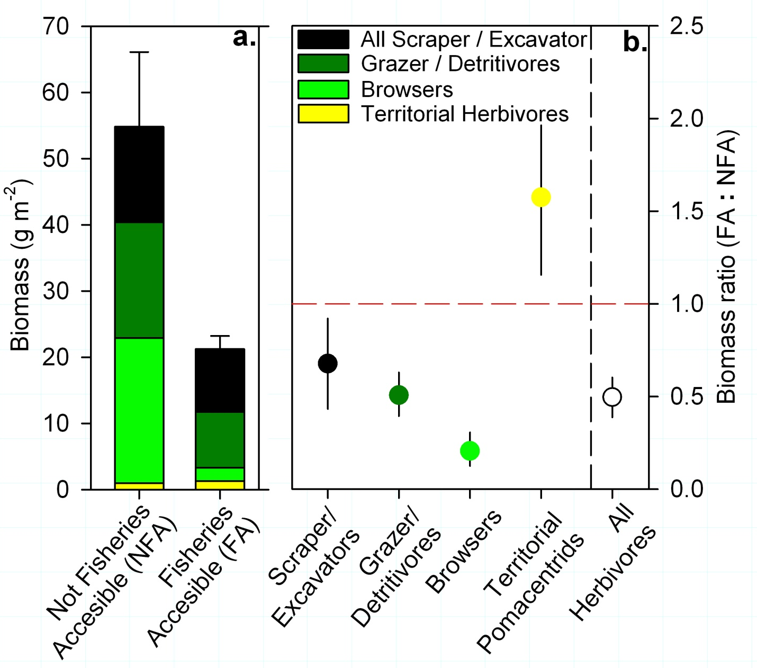
Results: functional group biomass
Notes:
A more detailed analysis of the global effects of fishing on the herbivore feeding guild was completed from 109 locations.
The output reported here are bootstrapped biomass ratio of NFA to FA locations worldwide…….. Distributions of ratios not overlapping 1.0 are evidence of difference between NFA and FA sites. Application of ratios allows us to interpret relative differences in means and to compare the magnitude in differences across functional groups that span wide ranges of mean biomass values.
None of the functional group response ratios overlapped 1, indicating significant differences for all of the guilds examined. Specifically, all non-territorial herbivores showed significant declines in biomass and no change in abundance at locations with fishing accessibility
When looking at particularly impacted browser guild (which focuses primarily on macroalgae), results suggest that Fisheries accessible herbivore assemblages may be unable to specifically control macroalgae increases. Likewise, an impoverished Scraper / Excavator group could indicate a lack of ability to clear bare space for colonizing CCAs and corals.
As different Functional groups fill complimentary rather than redundant roles on reefs, the the ability of the herbivore guild to contribute to resiliency and recovery processes relies on having adequate levels of all functional groups
Interestingly we found that unlike the other functional groups territorial damselfish actually increased in biomass and abundance.
The ability of territorial herbivores to repel con-specifics increases with body size, while numerical increases suggest that more reef area is occupied by this group at FA locations. Increases of territorial damselfish has been linked to declines in reef health and along with a commensurate reduction in herbivory associated with the lower overall biomass on FA reefs, may be an important warning sign of decline on some reefs.
----could be due to release from predators or competition

Slide 18
Conclusions
Over-exploitation of fish resources has large impacts on herbivorous fish assemblages
Fisheries accessibility changes the size structure of the herbivores guild; fished reefs are dominated by relatively abundant and smaller individuals
Herbivore biomass has declined in most regions; biomass levels as high as >100g m⁻² are found on many unfished reefs
Fisheries accessible reefs have altered functional group structure
Management schemes should take into consideration natural levels of the different functional groups of herbivores
Notes:
Conclusion:
Over-exploitation of fish resources has large impacts on herbivorous fish assemblages with over a two-fold decline in herbivore biomass at the global level

Slide 19
Conclusions
Over-exploitation of fish resources has large impacts on herbivorous fish assemblages
Fisheries accessibility changes the size structure of the herbivores guild; fished reefs are dominated by relatively abundant and smaller individuals
Herbivore biomass has declined in most regions; biomass levels as high as >100g m⁻² are found on many unfished reefs
Fisheries accessible reefs have altered functional group structure
Management schemes should take into consideration natural levels of the different functional groups of herbivores
Notes:
The decrease in biomass is not matched by a proportional change in abundance suggesting fished reefs are dominated by relatively abundant and smaller individuals.
Thus, reductions in total herbivore biomass will cause multiplicative declines in herbivory potential – less herbivore biomass to consume algae with less foraging capacity per unit biomass and a reduction in the clearing of base space for CCA and coral recruitment.
Ultimately this will result in a reduced ability of the herbivore guild to contribute to processes that maintain calcifier dominance on reefs

Slide 20
Conclusions
Over-exploitation of fish resources has large impacts on herbivorous fish assemblages
Fisheries accessibility changes the size structure of the herbivores guild; fished reefs are dominated by relatively abundant and smaller individuals
Herbivore biomass has declined in most regions; biomass levels as high as >100g m⁻² are found on many unfished reefs
Fisheries accessible reefs have altered functional group structure
Management schemes should take into consideration natural levels of the different functional groups of herbivores.
Notes:
We found that Reefs in nearly all regions have experienced declines in herbivore biomass, and that In many regions some unfished reefs can support biomass >100g/m^2 suggesting that management targets should consider biomass values at NFA locations when attempting to restore herbivore populations.

Slide 21
Conclusions
Over-exploitation of fish resources has large impacts on herbivorous fish assemblages
Fisheries accessibility changes the size structure of the herbivores guild; fished reefs are dominated by relatively abundant and smaller individuals
Herbivore biomass has declined in most regions; biomass levels as high as >100g m⁻² are found on many unfished reefs
Fisheries accessible reefs have altered functional group structure
Management schemes should take into consideration natural levels of the different functional groups of herbivores
Notes:
Fished reefs have experienced large reductions in the browser, scraper excavator and grazer detritivore groups
As these groups contribute to different processes, declines in one group or another may point to specific deficits in the ability of the herbivore assemblage to contribute to various aspects of reef resiliency
Interestingly we found that FA reefs have larger territorial damselfish assemblages both numerically and by weight. As this group has been linked to declines in reef health, our results suggest threats to FA reefs may extend beyond a diminished grazing capacity

Slide 22
Conclusions
Over-exploitation of fish resources has large impacts on herbivorous fish assemblages
Fisheries accessibility changes the size structure of the herbivores guild; fished reefs are dominated by relatively abundant and smaller individuals
Herbivore biomass has declined in most regions; biomass levels as high as >100g m⁻² are found on many unfished reefs
Fisheries accessible reefs have altered functional group structure
Management schemes should take into consideration natural levels of the different functional groups of herbivores
Notes:
TO maintain health of coral reefs worldwide, we should maintain healthy herbivore assemblages that can effectively control algae on reefs.
Given that herbivore functional groups fill complimentary rather than redundant roles, management strategies should maintain functional groups in the proper proportions

Slide 23
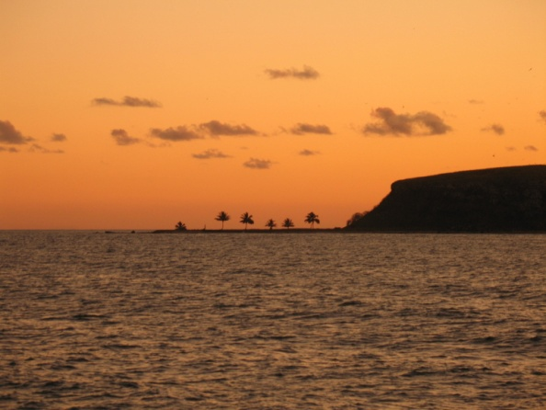
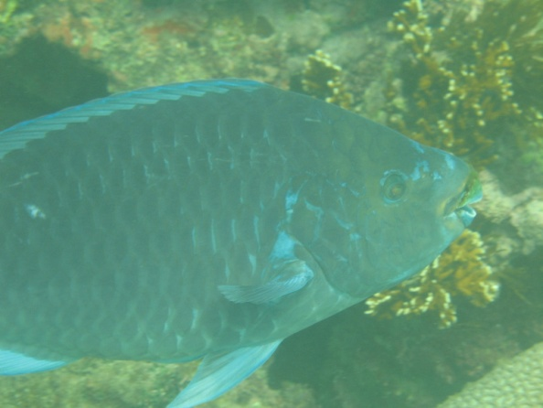

Thank You!!
Collaborators & Contributors:
Jennifer Smith
Stuart Sandin
Alan Friedlander
Ivor Williams
Alisson Green
Brian Zgliczynski
Marah Hardt
Hugh Sweatman
Australian Institute of Marine Science (AIMS)
NOAA Coral Reef Ecosystem Division (CRED)
The Nature Conservancy (TNC)
CAMEO (funding); NSF & NOAA
Thank you also….
Levi Lewis, Emily Kelly, Nichole Price
Andrew Lukosus
The entire Smith-Sandin academic-industrial-complex!!!
Notes:
With that I will conclude my talk and I would like to specifically thank all the collaborators and contributors with whom this work would not have been possible…..

Slide 24

Come see us!!!
For more information about this work and the other fascinating topics of research being conducted by myself and my colleagues please visit the Coral Reef Systems booth
(I will be there from 8-10 Tue/Thurs)

